Slide 1
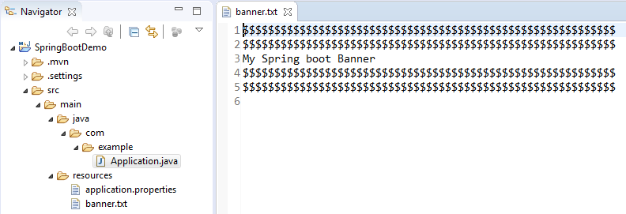
Spring Boot – Custom Banner example
To add a custom banner in Spring Boot application, create a banner.txt file and put it into the resources folder.
1

